Slide 1
Generalized Anxiety Disorder DATS 6401 – Final Term Project
Presented by:
Pranay Bhakthula

Slide 2

Today’s Discussion
Introduction
Dataset Description
Data Preprocessing
Outlier detection
PCA
Normality test
Data transformation
Heat map
Statistics
Data visualization
Results

Slide 3
Introduction
The focus of this project is to predict, and screen generalized anxiety disorder in people who play online games. The reason for selecting this dataset is most of the youth, educated, not educated as many are playing games so much time and it is becoming like their hobby. The cost is not only the money, but also their most precious time and health.

Slide 4
Dataset Description
The dataset used is sourced from Kaggle .
Source: https://www.kaggle.com/divyansh22/online-gaming-anxiety-data
With over 13000 participants, this is the biggest openly available dataset connecting gaming habits, various socio-economic factors and measures of anxiety, social phobia, life satisfaction and narcissism.
13464 users (12699 male, 713 female, 52 other) between 18 and 63 years (M = 20.93) completed the survey. Participants resided in 109 different countries with most of the participants coming from the USA (4569), Germany (1413), the UK (1032) and Canada (994).
We assessed
Background
Age and Gender
Country of origin
Country of residence
Employment status
Highest Degree earned

Slide 5
Dataset Description
Gaming habits
Main game played (+ ranking, if applicable)
Hours played per week
Platform
Motivation (fun, improvement, competition,...)
Sociality (singleplayer, multiplayer, etc...)
Validated Scales
Social Phobia Inventory (SPIN)
Generalized Anxiety Disorder Screener (GAD-7)
Satisfaction with Life Scale (SWL)
Single Item Narcissism Scale (SINS)

Slide 6
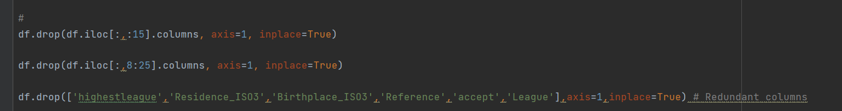
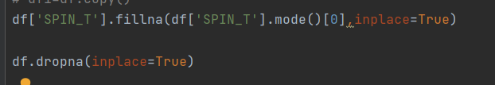
Data Preprocessing
1. Dropping redundant columns
2. Select top 5 types of playstyle. Drop rest of the rows
df.drop(df[(df['Playstyle']!='Singleplayer') & (df['Playstyle']!='Multiplayer - online - with strangers') & (df['Playstyle']!='Multiplayer - online - with online acquaintances or teammates') & (df['Playstyle']!='Multiplayer - online - with real life friends') & (df['Playstyle']!='Multiplayer - offline (people in the same room)') & (df['Playstyle']!='all of the above')].index,axis=0,inplace=True)
3. Fill SPIN_T with mode of the columns and drop rest of the missing rows

Slide 7
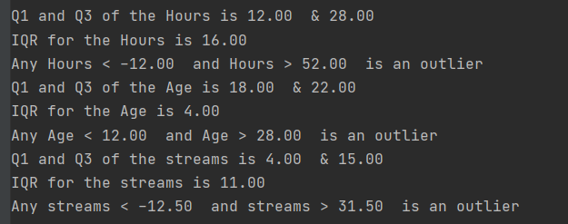
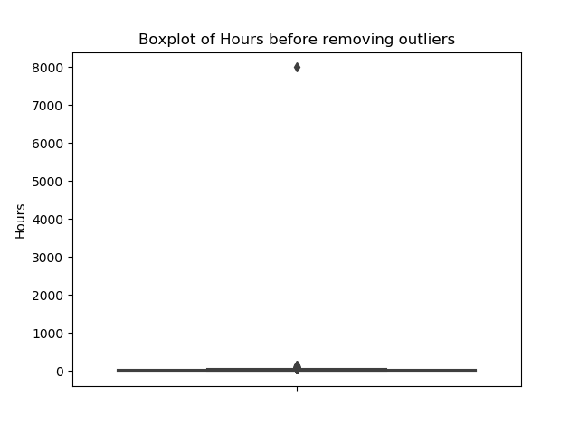
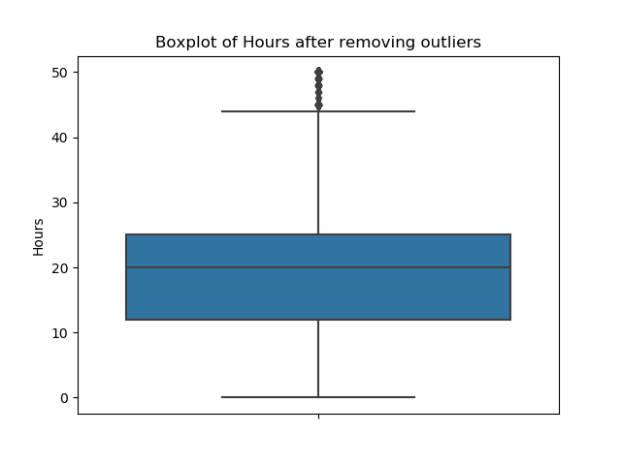
Outlier detection & removal
Use quantile and IQR to drop the outliers.
Below are the boxplots of hours, Age and streams before and after outlier removal

Slide 8
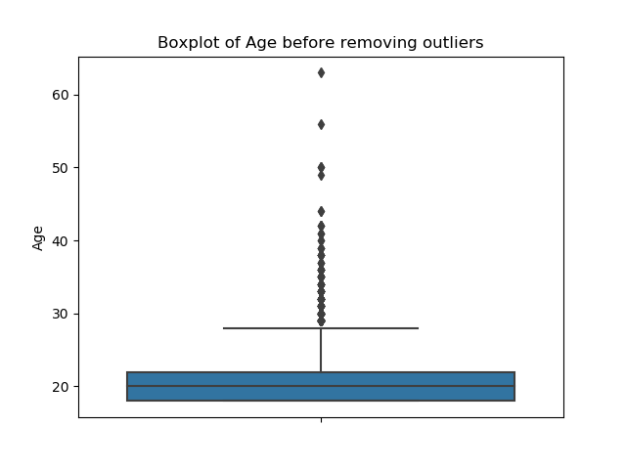
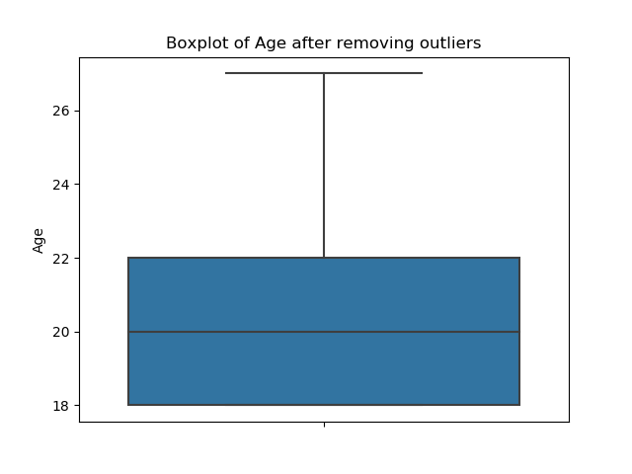
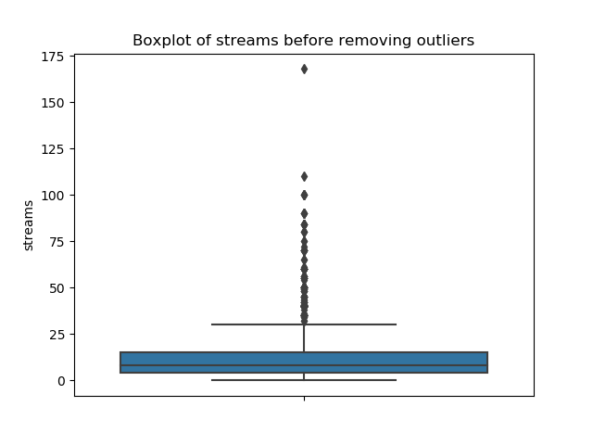
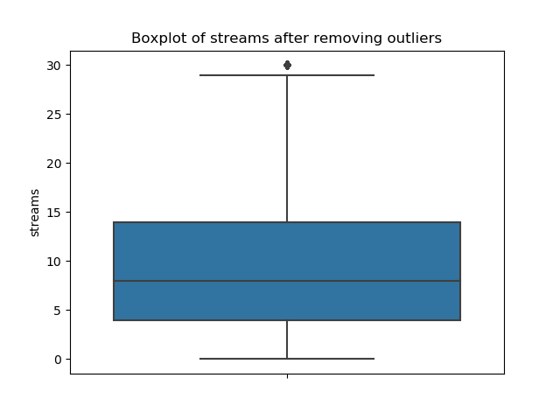

Slide 9
Principal Component Analysis (PCA)
No singular values are near 0, this mean no 2 variables are correlated strongly and non of the variables needed to be dropped.
Condition number is < 100, so this has weak degree of co-linearity (DOC).

Slide 10
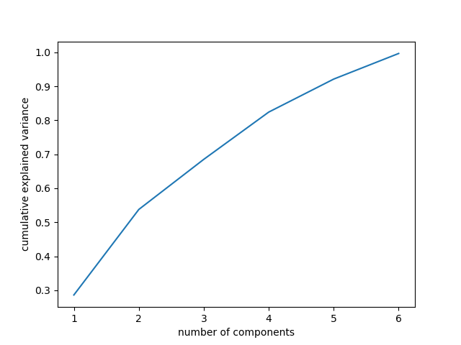
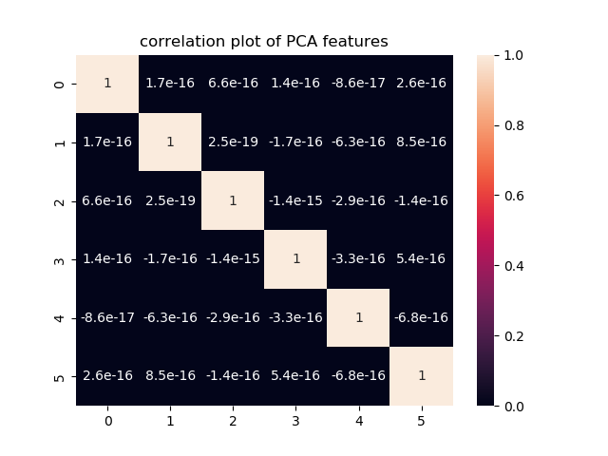

Slide 11
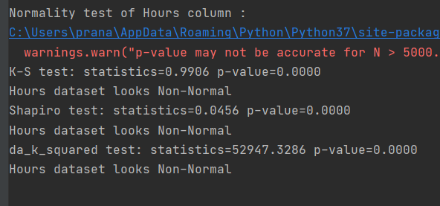
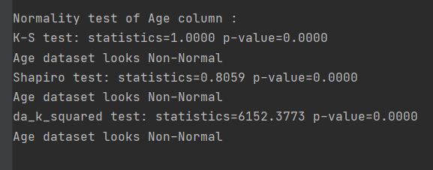
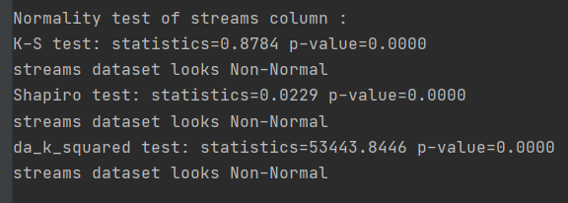
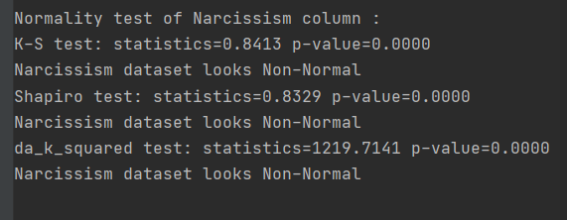
Normality test

Slide 12
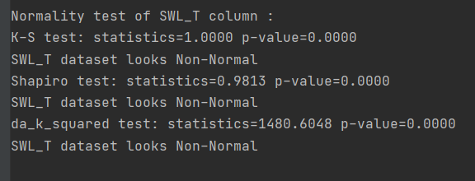
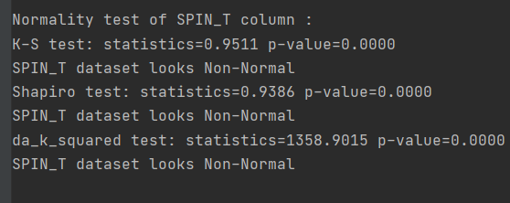
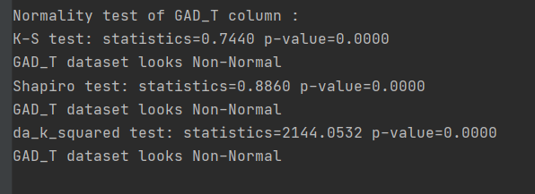
From the normality test of all the numeric data, we can see that non of the variable is Normally distributed

Slide 13
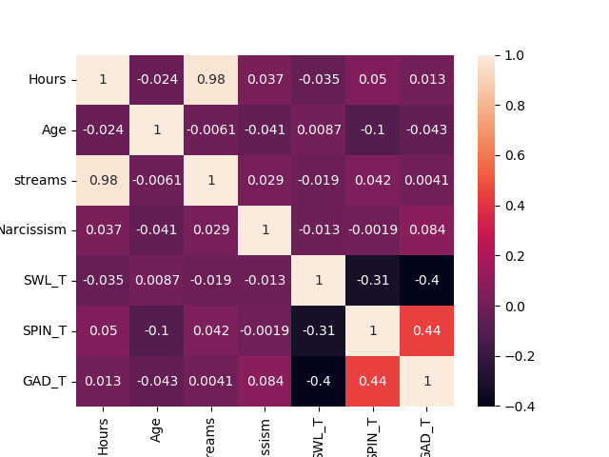
Heatmap & Pearson correlation coefficient matrix
We can observe that from the correlation plot all the columns as weakly correlated with each other.

Slide 14
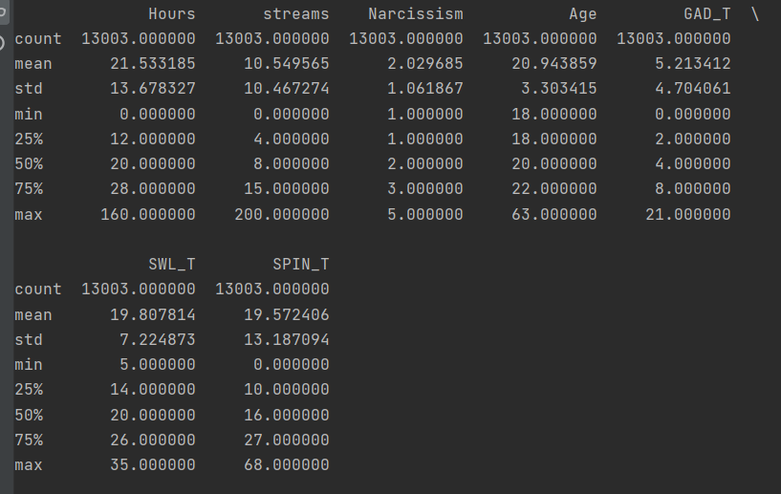
Statistics
We can observe that most of the data is within 10-20 range by observing the means.
Narcissism has the least mean and Hours has the highest mean
Narcissism has the least standard deviation and Hours has the highest standard deviation, SPIN_T standard deviation is very close to Hours

Slide 15

Data visualization

Slide 16
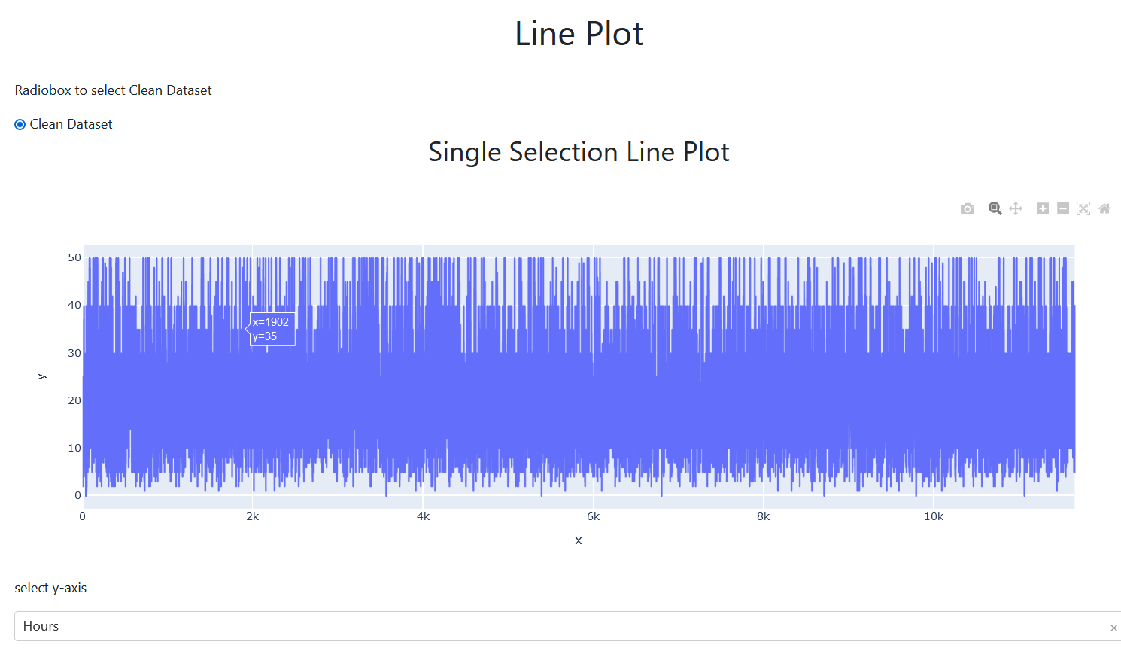
Line plot

Slide 17
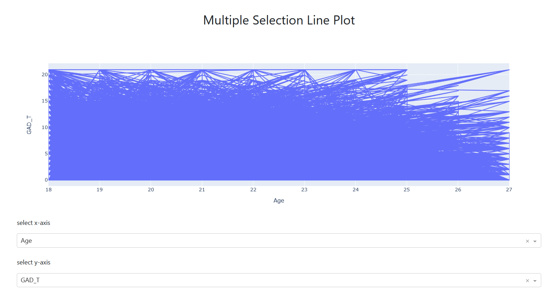

Slide 18
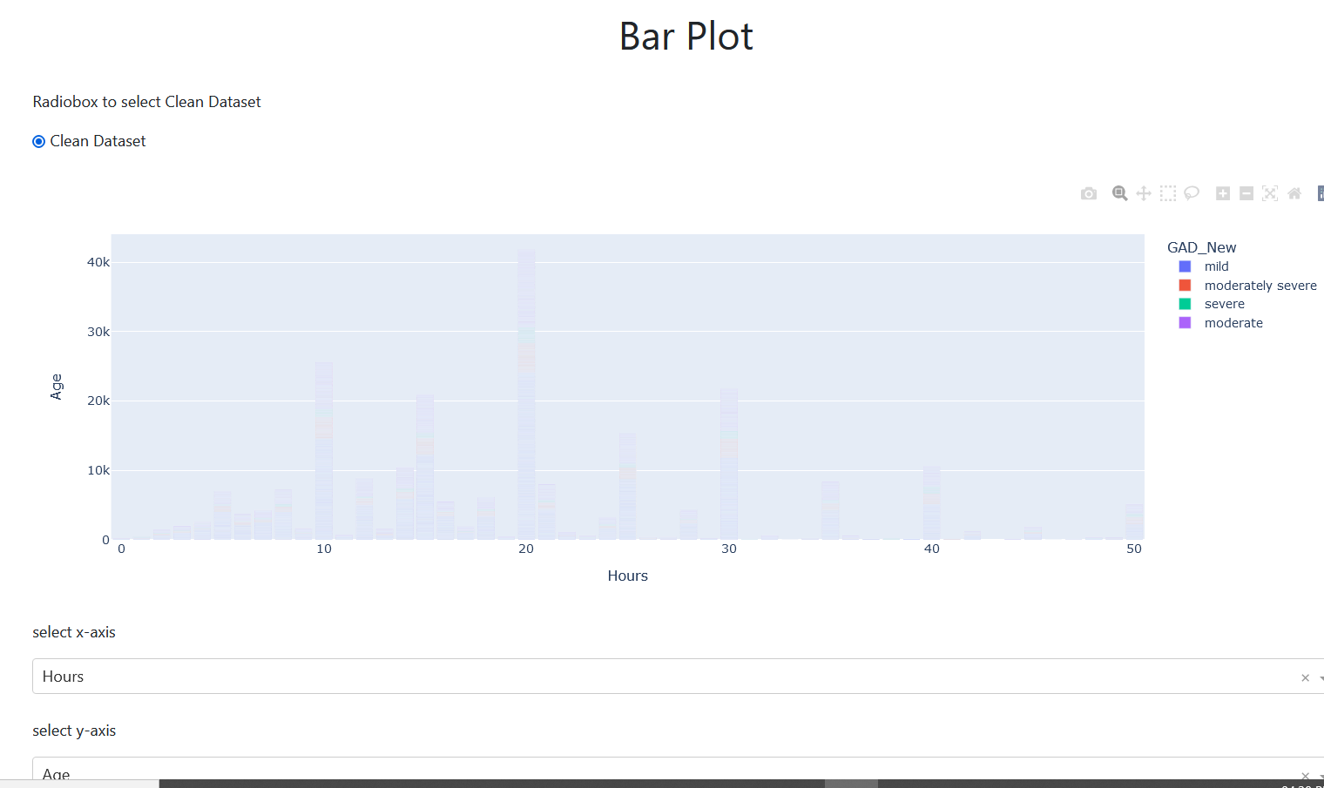
Bar plot : stack, group

Slide 19
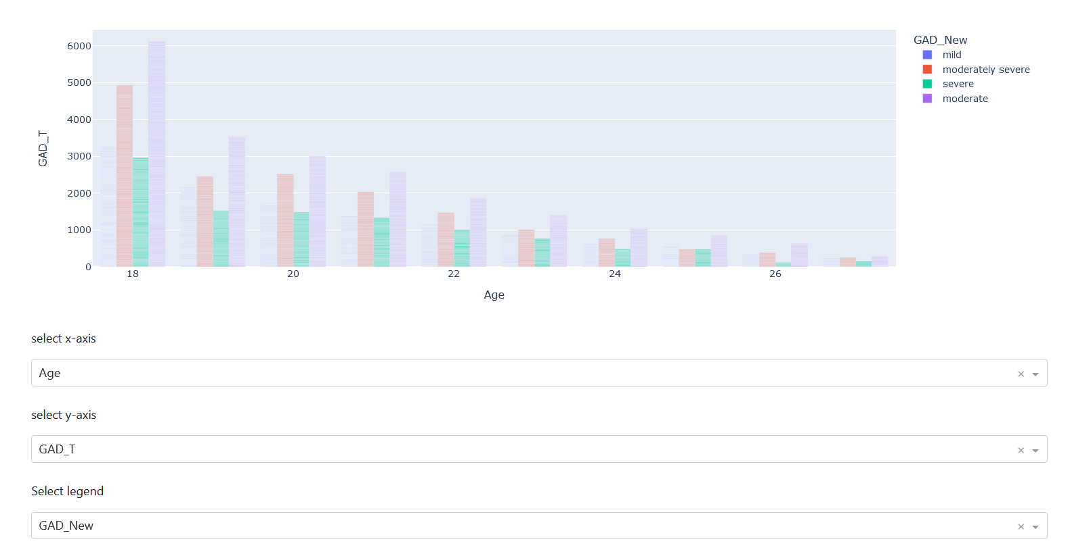
Bar group plot

Slide 20
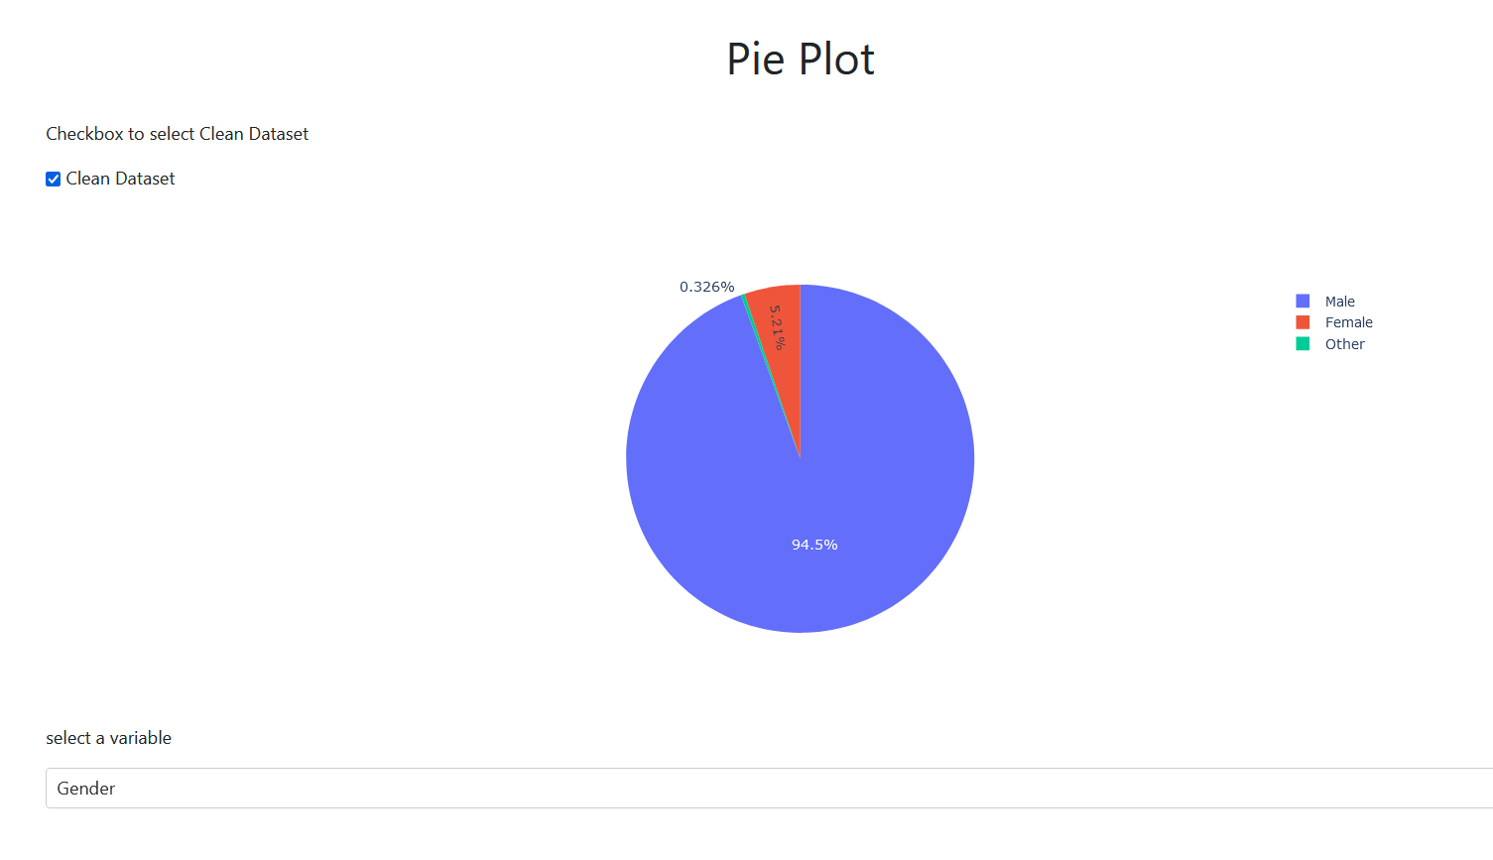
Pie chart

Slide 21
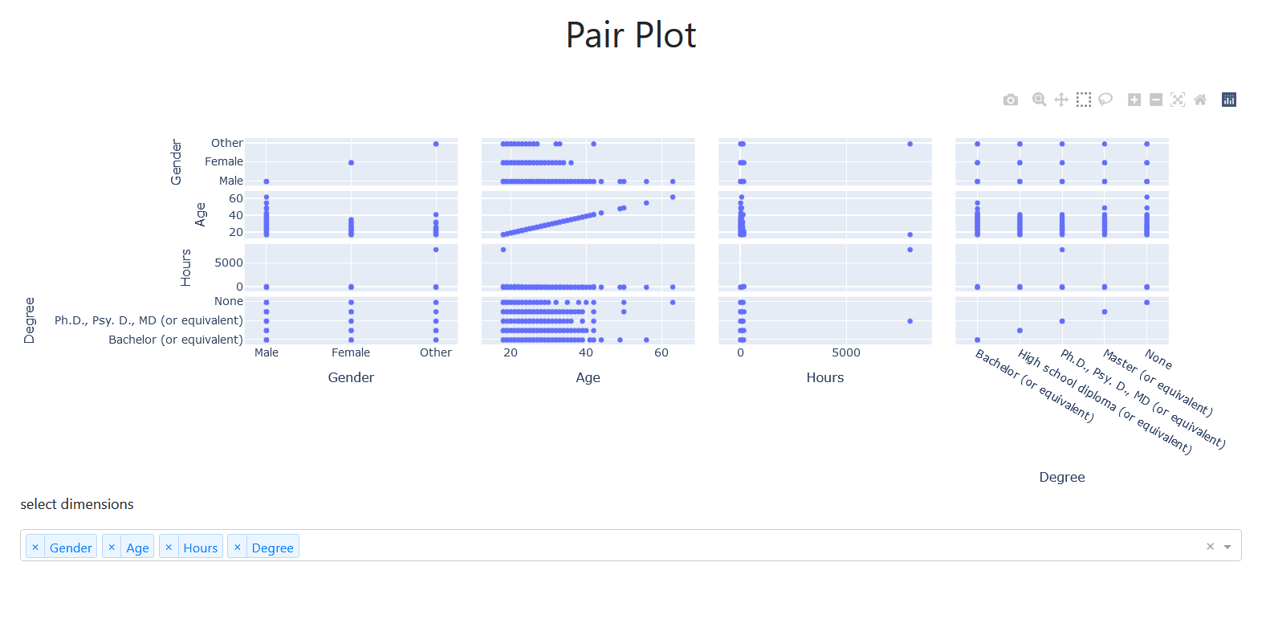
Pair plot

Slide 22
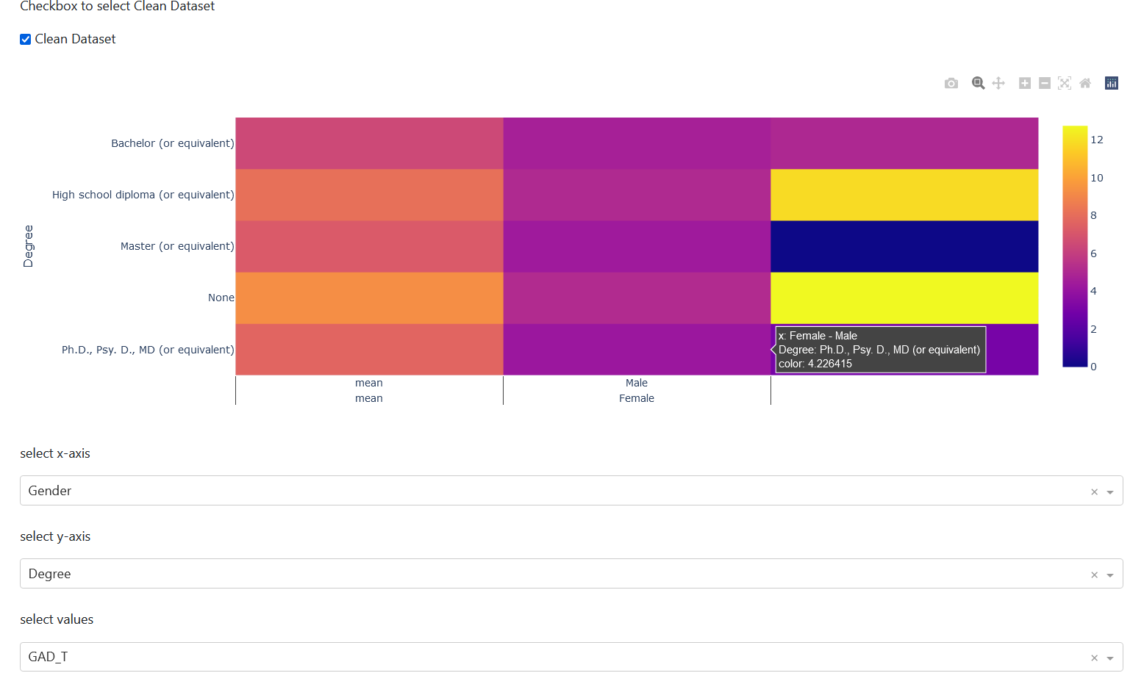
Heatmap

Slide 23
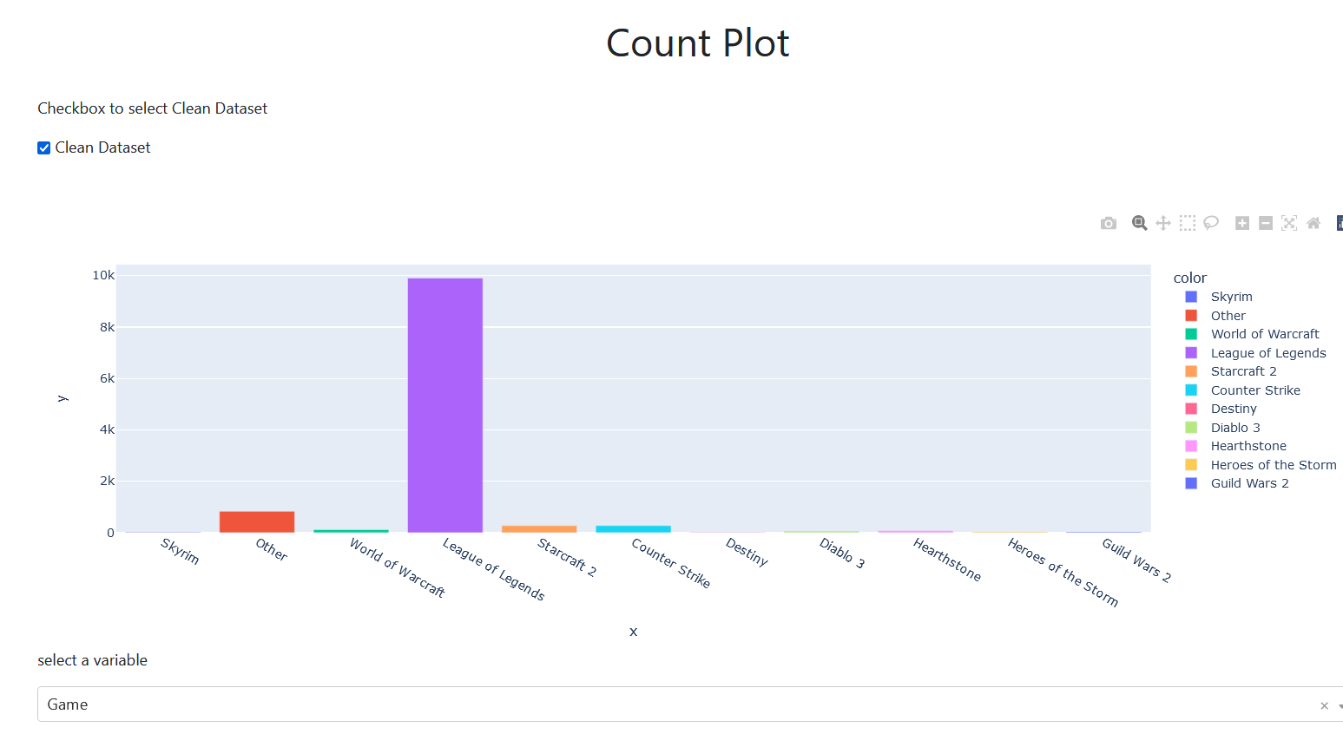
Count plot

Slide 24
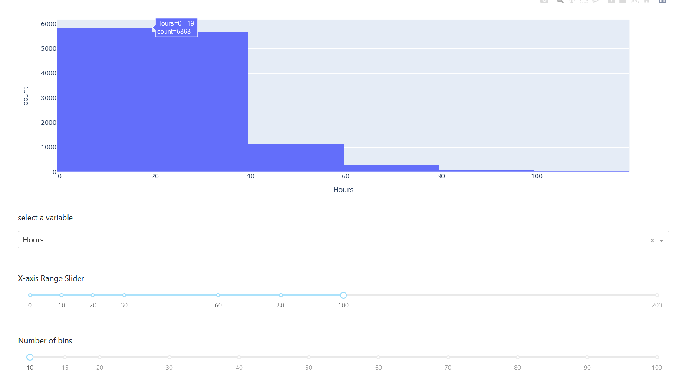
Histogram plot

Slide 25
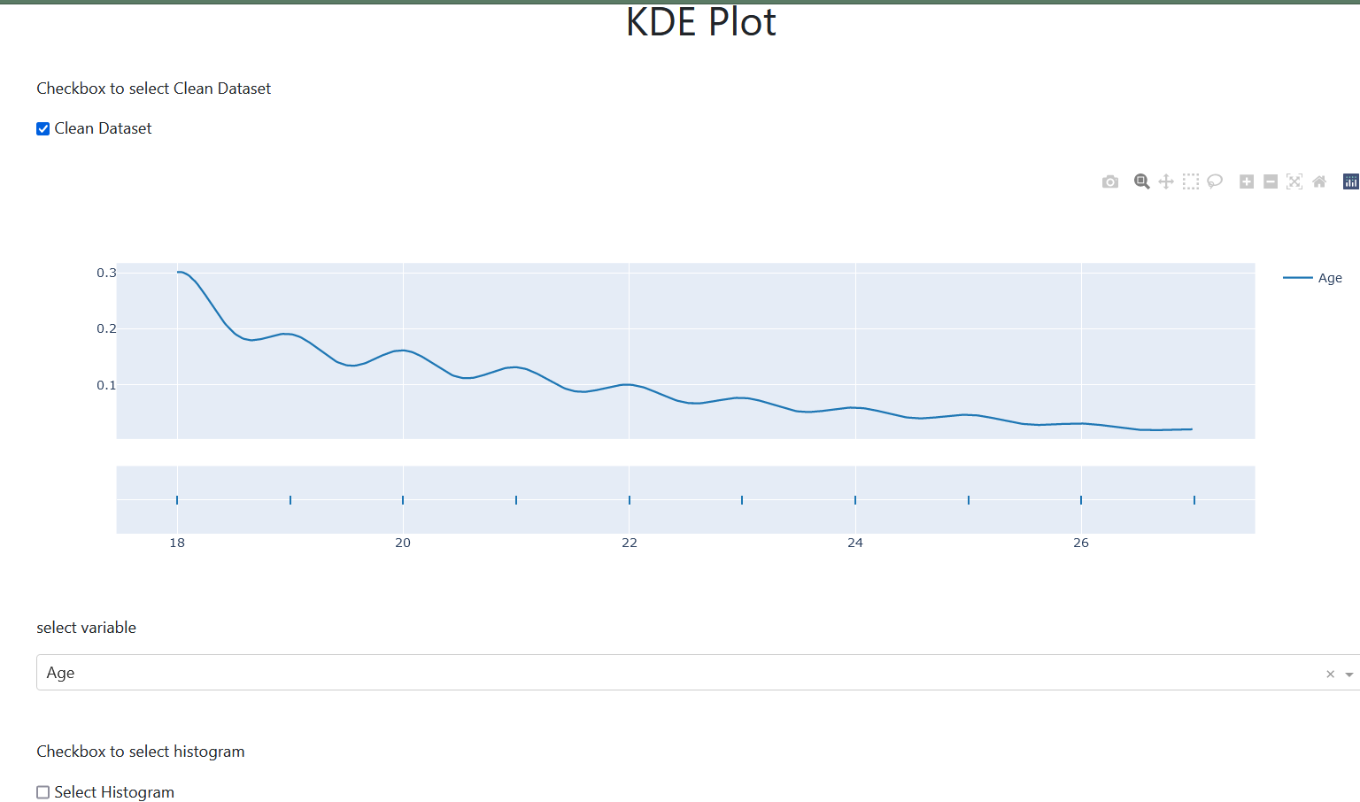
Kernal density estimate

Slide 26
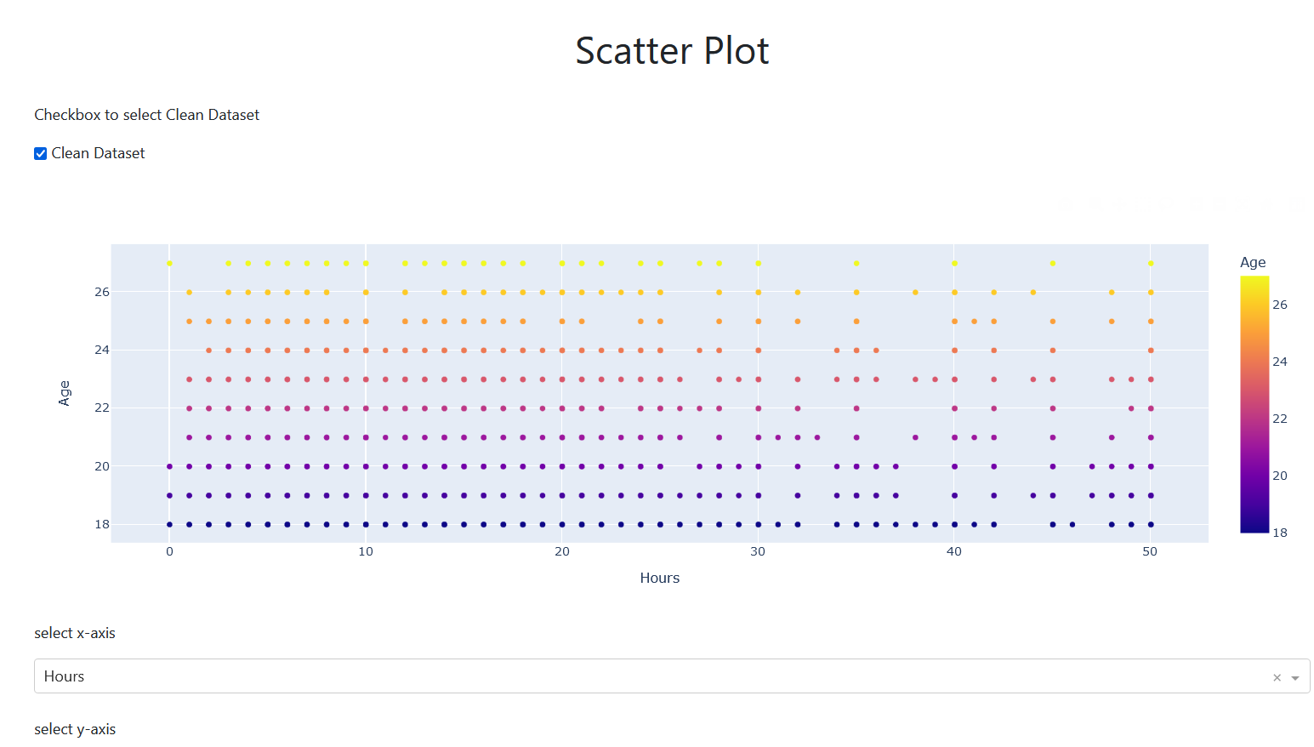
Scatter plot and regression line using sklearn

Slide 27
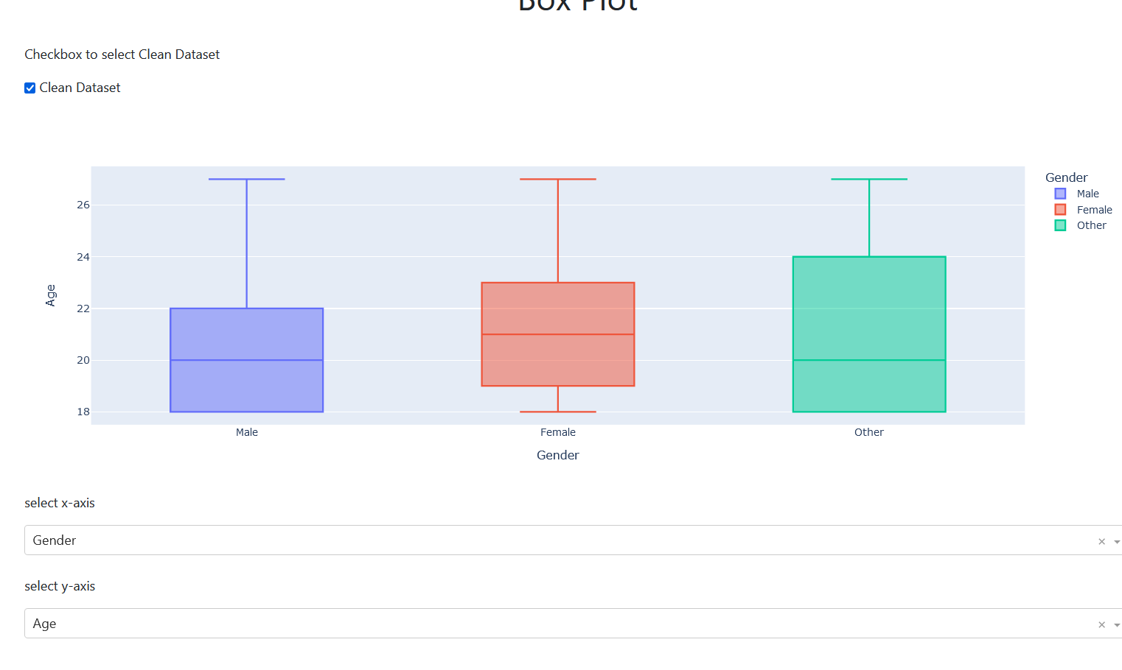
Multivariate Box plot

Slide 28
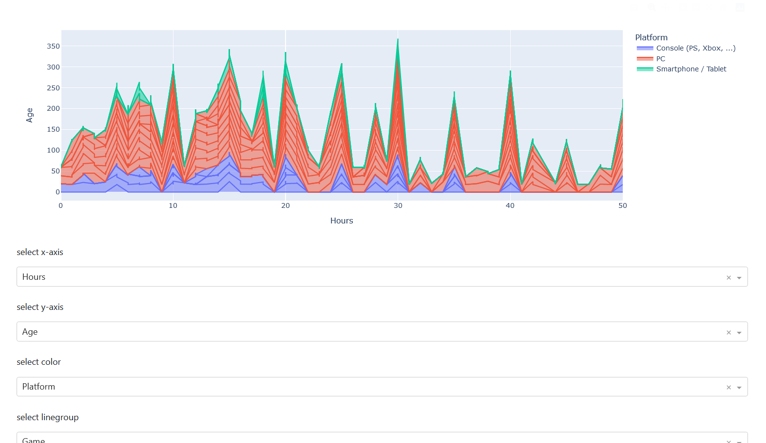
Area plot

Slide 29
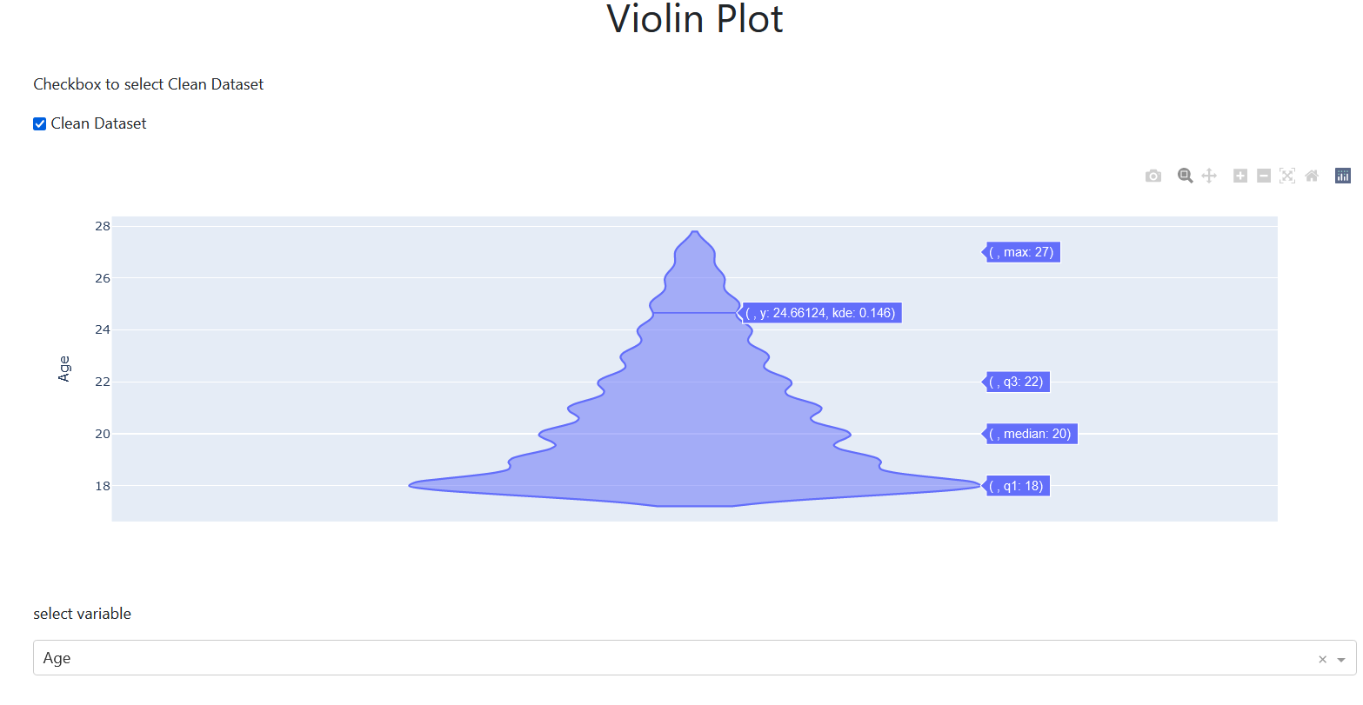
Violin plot

Slide 30
Results
We can observe that majority of the online gamers are in the age 12 – 28
Majority of the online gamers are male gender and minority are other gender
Students are majority of the online gamers and minority are unemployed .
Majority of online gamers are from High school diploma and minority are above ph.d level
Most popular game is league of legends

Slide 31
Conclusion
In conclusion, we can say that people between the age 14-25 need to reduce online gaming time so that they can increase their mental health.
If we allow this to continue, future would have lot of people with mental health problems and they might have decreased brain capacity to think sharply and quickly.

Slide 32
Thank You

